Slide 1
Trevecca Nazarene V.S Freed-Hardeman
Kassius Banks

Slide 2
Quick Facts
Trevecca Nazarene
Freed-Hardeman
Website-trevecca.edu
School Type: Private/Four Year
Undergraduate Enrollment: N/A
Average Classroom Size:17.5
Distance from Memphis:3hr 11min
Website:fhu.edu
School Type: Private/Four Year
Undergraduate Enrollment: N/A
Average Classroom Size:20
Distance from Memphis:1hr 40min

Slide 3
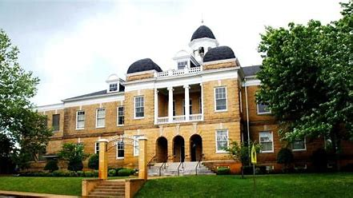
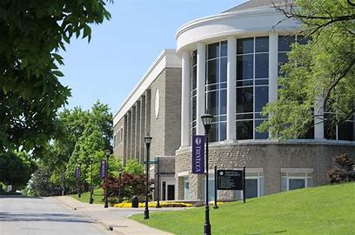
Studies
Trevecca Nazarene
Freed-Hardeman
Elementary and Middle School Administaration/Principalship
Elementary Education and Teaching
English/Language Arts Teacher Education
History Teacher
Mathematics Teacher Education
Music Teacher Education
English/Language Arts Education
Health Teacher Education
History Teacher Education
Junior High/Intermediate/Middle School Education and Teaching
Social Studies Teacher Education
Science Teacher Education
Secondary Education and Teaching
Special Education and Teaching, General

Slide 4
Organizations and Sports
Trevecca Nazarene
Freed-Hardeman
Academic Clubs
Business
Commuter
Track and Field
Softball
Flag Football
Cross Country
Sand Volleyball
Baseball
Basketball
Cheerleading
Choir
Newspaper
Orchestra
Soccer
Tennis
Radio Station

Slide 5
Costs
Trevecca Nazarene
Freed-Hardeman
Average Pell Grant Amount:$3,926
Annual Tuition:$24,200
Average Grant Amount:$13,466
Annual Room and Board:$8,808
Average Pell Grant Amount:$4,129
Annual Tuition:$21,950
Average Grant Amount:$14,441
Annual Room and Board:$8,260

Slide 6
Ratings and Reviews
Trevecca Nazarene
Freed-Hardeman
Overall Quality Rating: 3.4
Safety: 3.9
Food: 2.5
Facilities: 3.8
Review: The Professors give good feedback to their students and they also are on topic on what they are teaching and is very caring to their students.
Overall Quality Rating: 3.7
Safety: 4.5
Food: 2.8
Facilities: 3.8
Review: The Professors are enthusiastic towards the students they are wonderful at teaching and they're very generous and kind to the students.

Slide 7
The Best Choice: Freed-Hardeman
Supporting evidence: It's 1hr and 40min away from Memphis
Supporting evidence: The Tuition($21,950) is cheaper than Trevecca's
Supporting evidence: The Overall Quality Rating is 3.7
Supporting evidence: The Professors are very eager and passionate towards they're students

Slide 8
Tennessee Teacher Wages
Elementary School Teacher: $53,914
Middle School Teacher: $47,735
Secondary School Teacher: $56,301

Slide 9
Sources
Naviance
ratemyprofessors.com
www.salary.com

