Slide 1
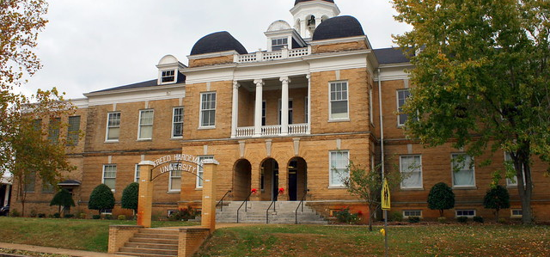
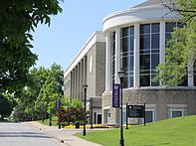
Trevecca Nazarene OR Freed-Hardeman
Courtirea C Dockins

Slide 2
Quick Facts
Freed-Hardeman
School Type ? Private / Four Year School
Undergraduates ? 1,471
Degrees Offered ? Associates / Bachelor's / Graduate Certificate / Master's
1hr 40mins drive from Memphis to Freed Hardeman
Trevecca Nazarene
School Type ? Private / Four Year School
Undergraduates ? 2,219
Degrees Offered ? Certificate / Associate's / Bachelor's / Graduate Certificate / Master's / Doctorate
3hrs 9mins drive from Memphis to Trevecca Nazarene
.

Slide 3
S T U D I E S
Freed – Hardeman
Trevecca Nazarene
Early Childhood Education and Teaching
English/Language Arts Teacher Education
Mathematics Teacher Education
History Teacher Education
Physical Education Teaching and Coaching
Educational/Instructional Technology
Elementary Education and Teaching
Educational Leadership and Administration, General
Art Teacher Education
Biology Teacher Education
Counselor Education/School Counseling and Guidance Services
Curriculum and Instruction
Early Childhood Education and Teaching
English/Language Arts Teacher Education
Health Teacher Education
Junior High/Intermediate/Middle School Education and Teaching

Slide 4
! O R G A N I Z A T I O N S & S P O R T S !
Freed – Hardeman
Trevecca Nazarene
Campus Delegate Team (CDT)
Student Alumni Association (SAA)
University Program Council (UPC)
XI CHI DELTA
CHI BETA CHI
PHI KAPPA ALPHA
SIGMA RHO
THETA NU
SGA
RHA
Futuro
Best Buddies
Social Justice Club
Namaste
Concert Team
OCCM - Orthodox Christian Campus Ministries

Slide 5
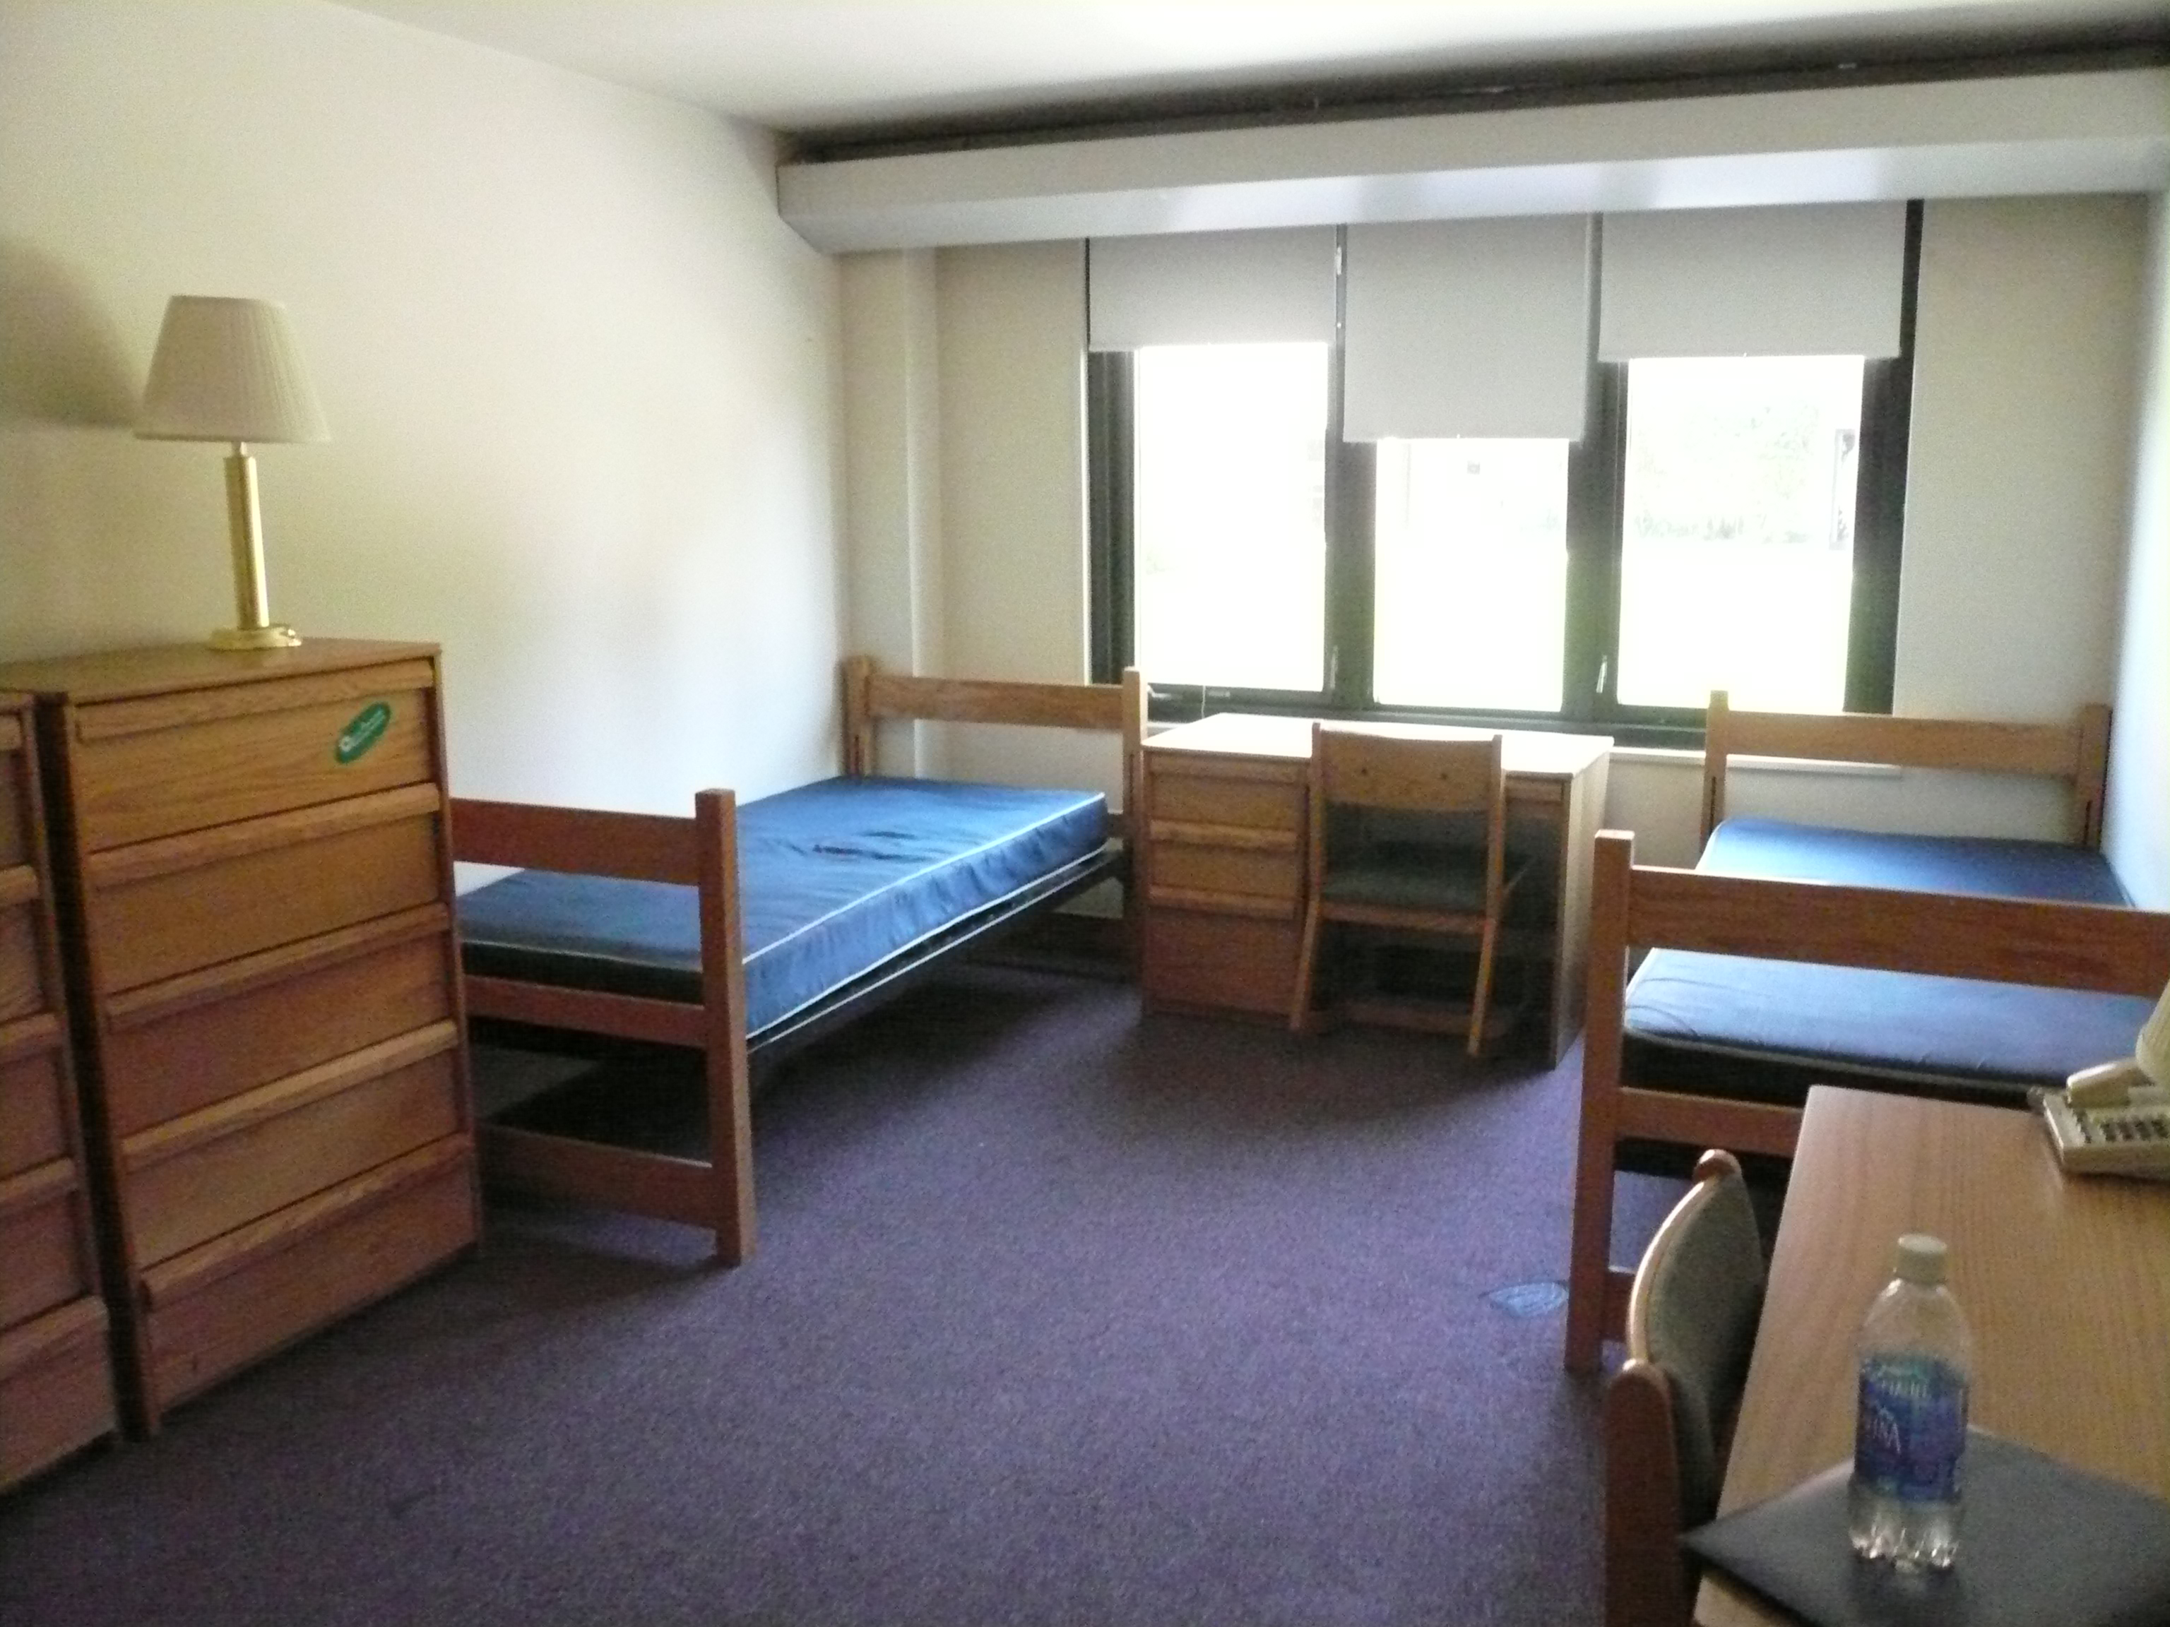
$C O S T !
Trevecca Nazarene
Freed - Hardeman
Fees - $900
Room & Board - $8,808
Tuition per credit hour - $935
Total Cost - $33,908
Financial Aid - $13,466
Average Net Price - $14,546
Fees - $1,568
Room & Board - $8,260
Tuition per credit hour - $21,950
Total Cost - $30,210
Financial Aid - $14,441
Average Net Price - $13,965

Slide 6
Rating && Reviews ..
Freed - Hardeman
Clubs – 4.1
Happiness – 3.9
Safety – 4.5
Food – 2.8
Social – 3.9
" I have really loved my time here at Freed, and I'm sad that I am graduating in May. "
" It's great to be at Harding."
" I love this school, these people, and everything about it. It's small and there's not a lot here, but if you're looking for a way to make good connections then this is your place. "
" The school itself is fairly unlovable. Average at best. But if you are like minded to the individuals here you will love them and they will love you. "
Trevecca Nazarene
- Club – 2
- Food – 3
- Opportunities 4
- Safety – 5
- Social – 3
" It's alright, but it's iffy. "
" everything I expected it to be! love the sense of community and how you know almost everyone "
" Trevecca is great "
" Overall a great school! Everyone is friendly and kind, if you're looking at colleges check Trevecca out! "

Slide 7
Freed – Hardeman
Freed Hardeman university has all grade levels of schools , from early childhood , middle , and high school .
Their reviews was also higher than Trevecca Nazarene reviews .
Its a shorter drive than from Memphis than Trevecca Nazarene .
Many people have good things to say about this university .
Have many different clubs , organizations , and sports .
They have courses and exams schedules , studies and more .
" The liberal arts core introduces students to FHU’s essential learning outcomes and prepares students for growth in these areas throughout the duration of their studies while at Freed-Hardeman University. "

Slide 8
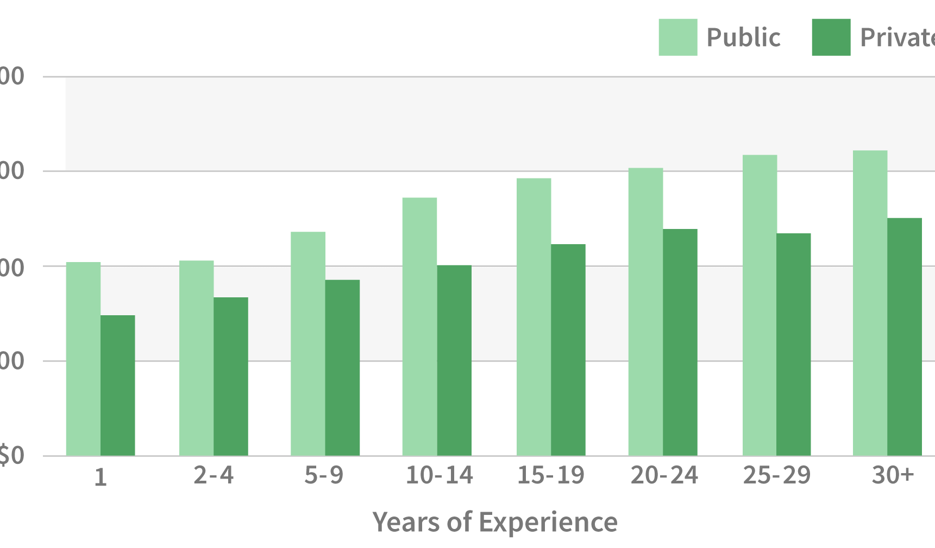
Wages …
The average Teacher Elementary School salary in Tennessee is $53,914
The national average salary for a Middle School Teacher is $44,175
The average secondary school teacher salary in Tennessee, United States is $56,132

Slide 9
Sources !!
Naviance.com
www.fhu.edu
www.usnews.com
www.trevecca.edu

