Slide 1
Physical fitness
LaKya Mallett
This Photo by Unknown Author is licensed under CC BY-SA

Slide 2
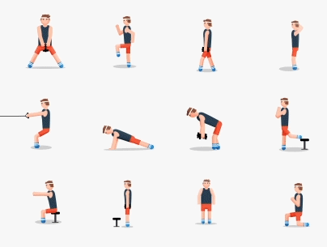
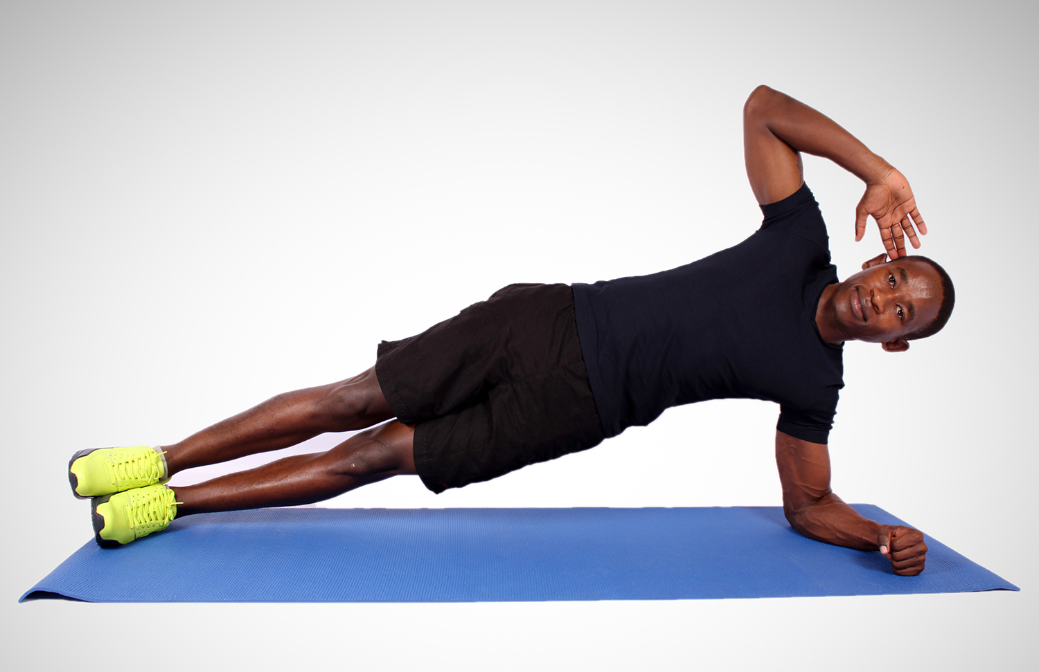
Cardio & Strength exercises
Cardio exercises
Strength exercises
Running
Jumping jacks
Box jump
Swimming
walking
squats
Push ups
Running
Lunges
planks
This Photo by Unknown Author is licensed under CC BY-SA-NC

Slide 3
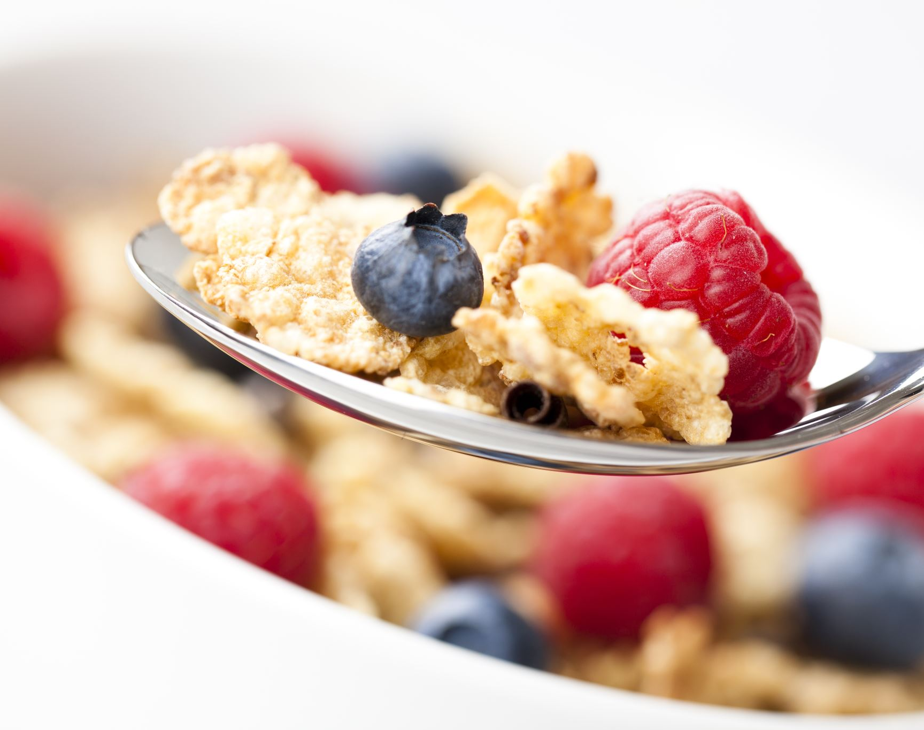
Health eating
Eating fruit and vegetables
Low fat milk
Whole grains
Fish
eggs

Slide 4
sources
www.stylecraze.com/articles/cardio-exercises-you-can-do-at-home
aaptiv.com/magazine/best-strength-training-exercises-beginner
https://www.self.com/story/strength-exercises-all-beginners-should-lear
www.cdc.gov/healthyweight/healthy_eating/index.htm

