Slide 1
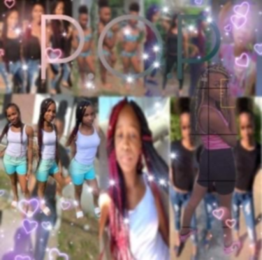

Getting to Know Me
Precious Miller

Slide 2
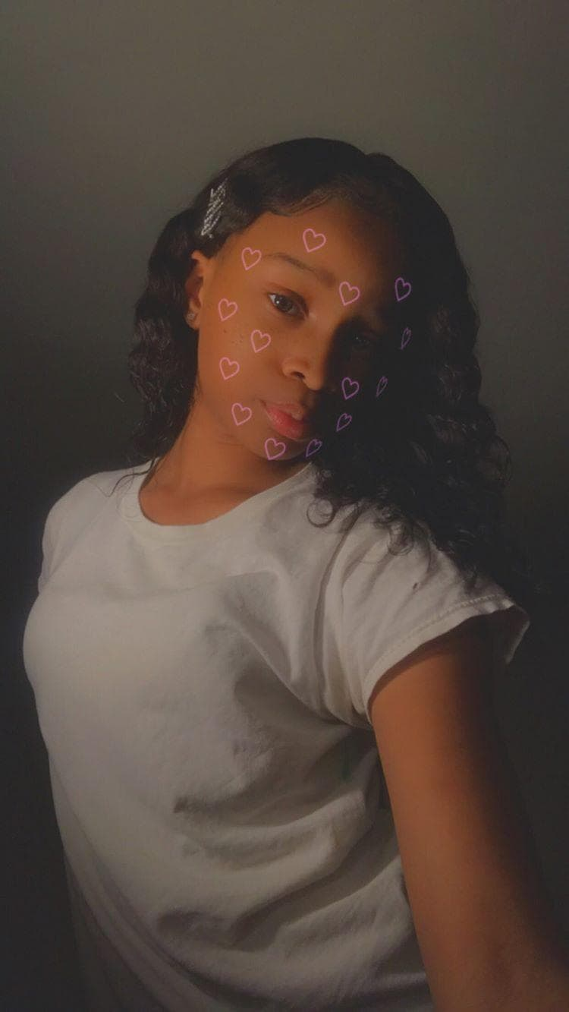
Facts About Me
PrettyP
January 4, 2007
13
8th Grade

Slide 3

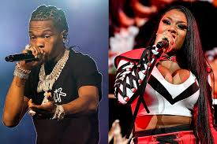

My Favorites
Hobbies- Volleyball and Majorette
Fav. Food- Hots wings & Crab Legs
Fav. Artist- So Icy Gang(New 1017),
Lil Baby, Megan Thee Stallion
Shows- Power/Book II, All American, Black Lighting

Slide 4
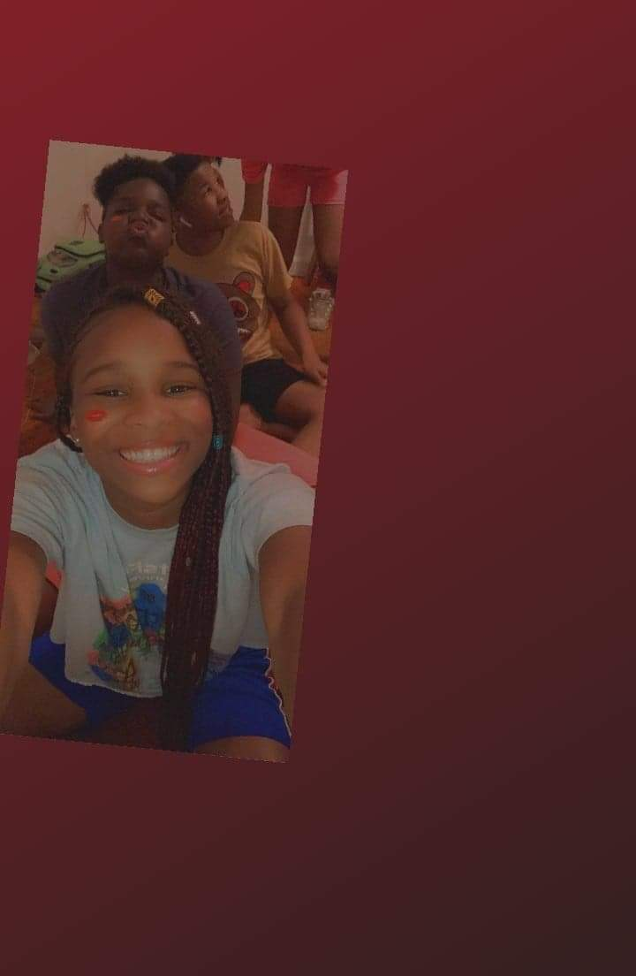
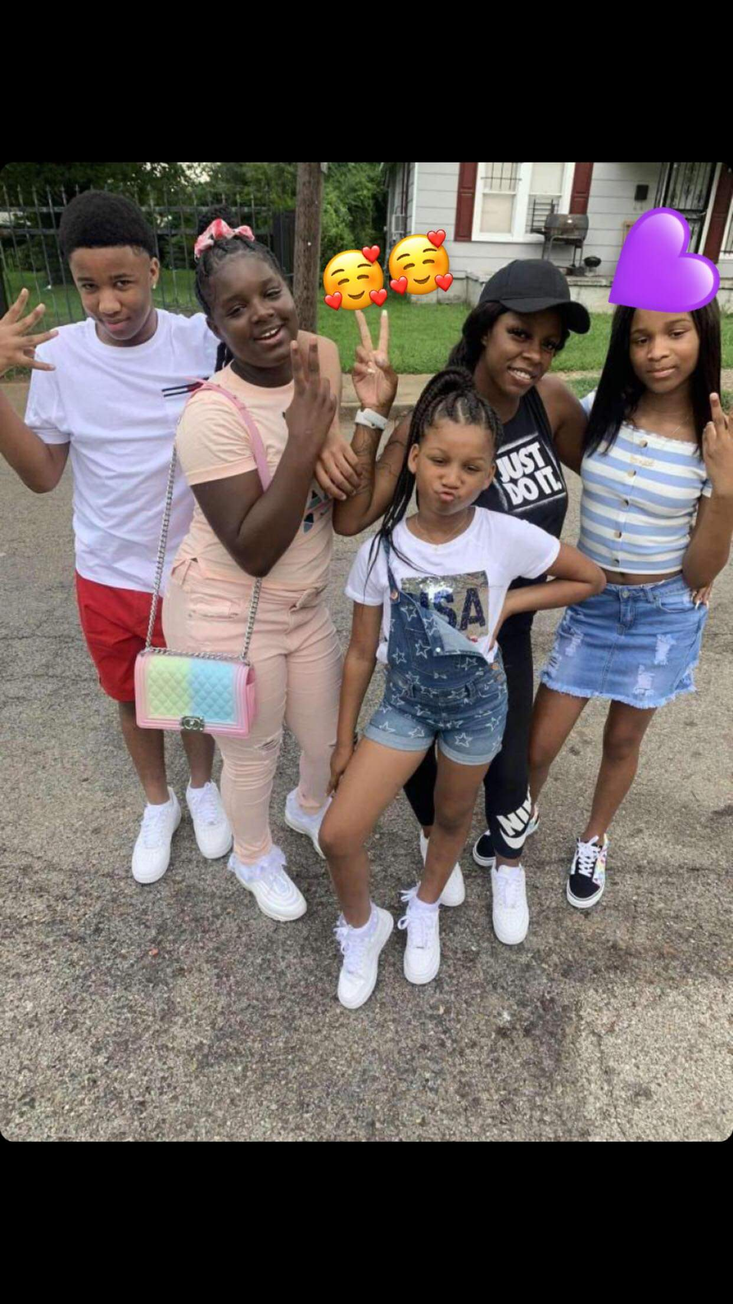
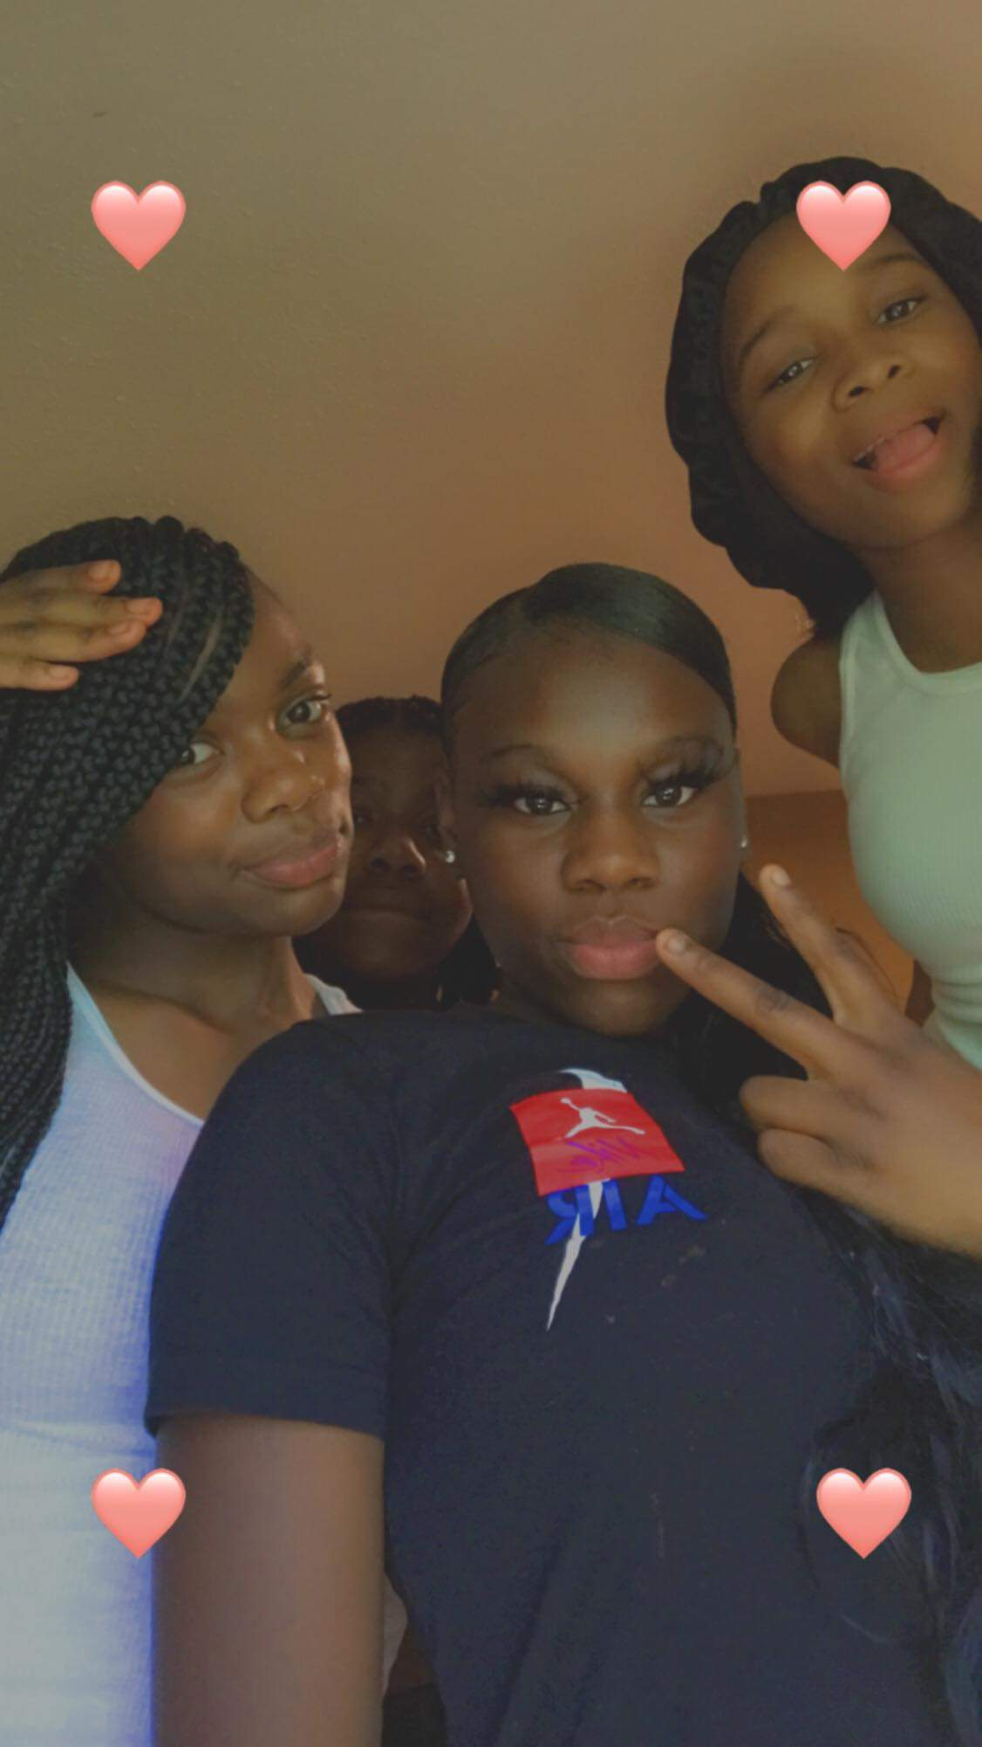
Family and Friends
Family
Friends
Tete Johnna (Auntie)
Yabobian (Cousin)
Laderria (Cousin)
Courtirea
Jayla
Makayla

