Slide 1
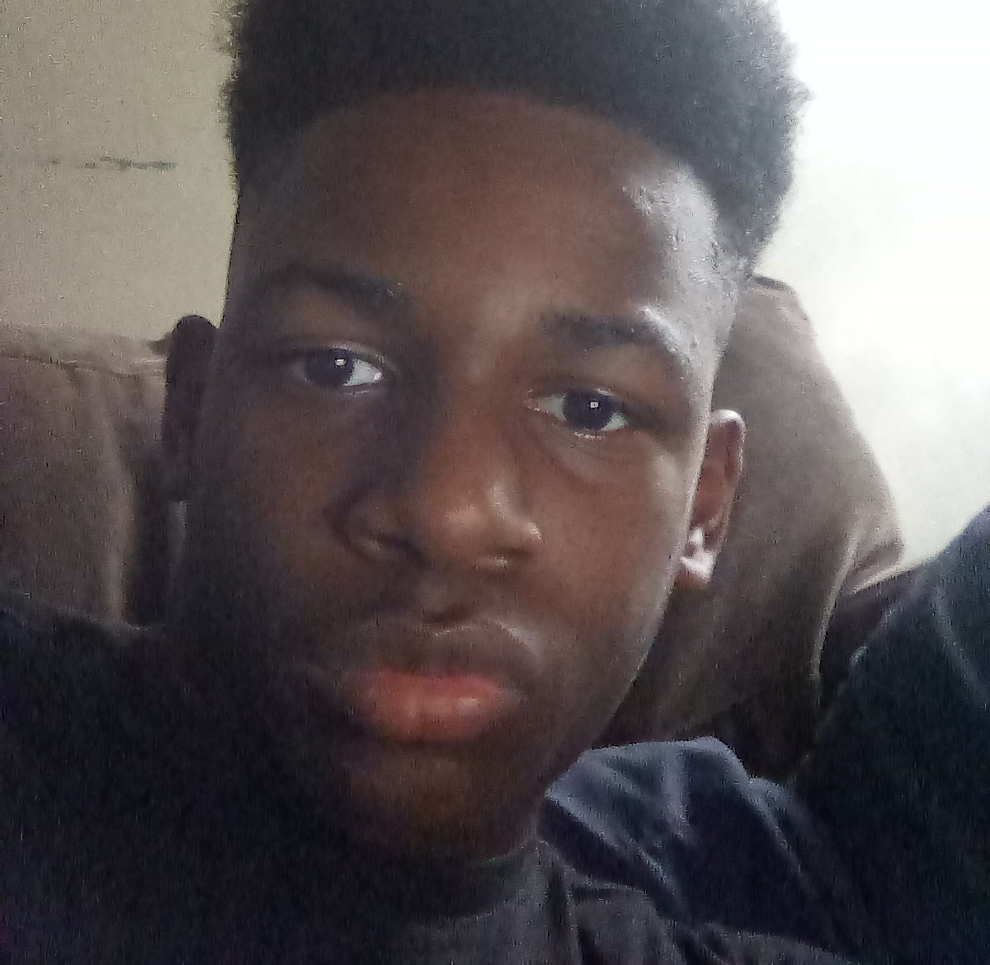
Getting To Know Me
Jeremiah Patton

Slide 2
Facts About Me
Big warm
01/08/2007
13
8th

Slide 3
My Favorites
Play Football
Pizza
NLE
The Vampire Diaries

Slide 4
Family and Friends
Family
Friends
Grandma CC
Big Bother
Lil Bother
Lil Cousin
God Bother
Football Coaches
Daniel
Bam

