Slide 1
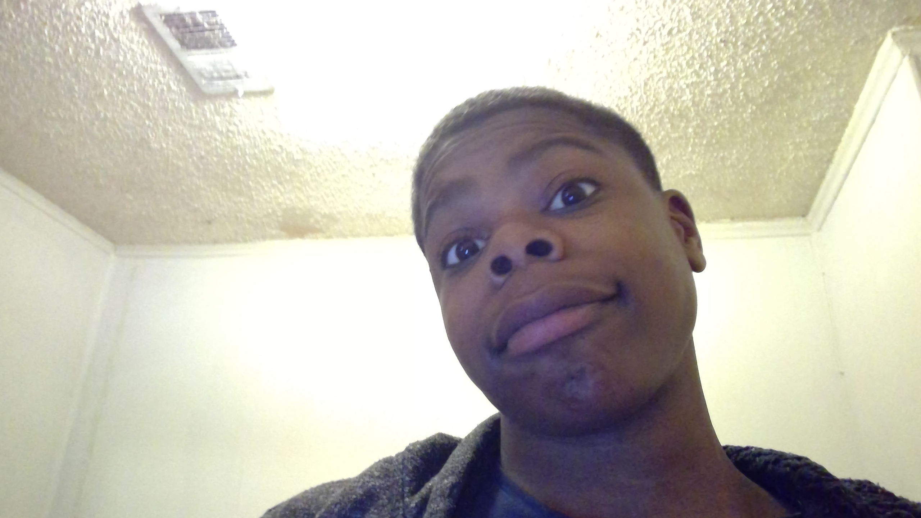

Getting To Know Me
James Richardson

Slide 2
Facts About Me
Nickname: Jay
BDay: May 21 2020
Age: 13
Grade 8th

Slide 3
My Favorites
My Hobbies: Football, Basketball
My Foods: Hotwings, Baked Chicken
My Music/Artist: NBA Youngboy, Yella Beezy
My Shows/ Movies: The Killer Clown From Outer Space

Slide 4
Family and Friends
Family
Friends
My Mom
My Dad
My Sisters
My Brother
My Auntie
My GrandMomma
My GrandDaddy
Adam
Jayden
Janiya
Tony
Diamond
Tarus
Tyler

