Slide 1
Getting to know me.
Jadan haraway

Slide 2
Facts about me.
November 29
JD
I like sports

Slide 3
My favorites
Science favorite subject
Hot wings

Slide 4
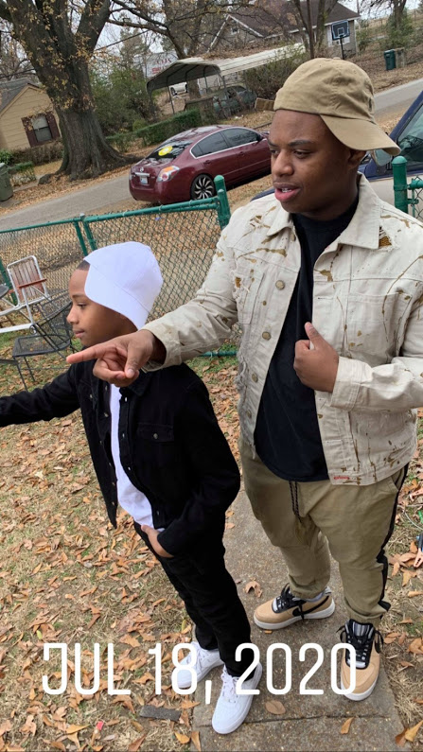
Family
Jylon, brother
Rylie, sister

