Slide 1
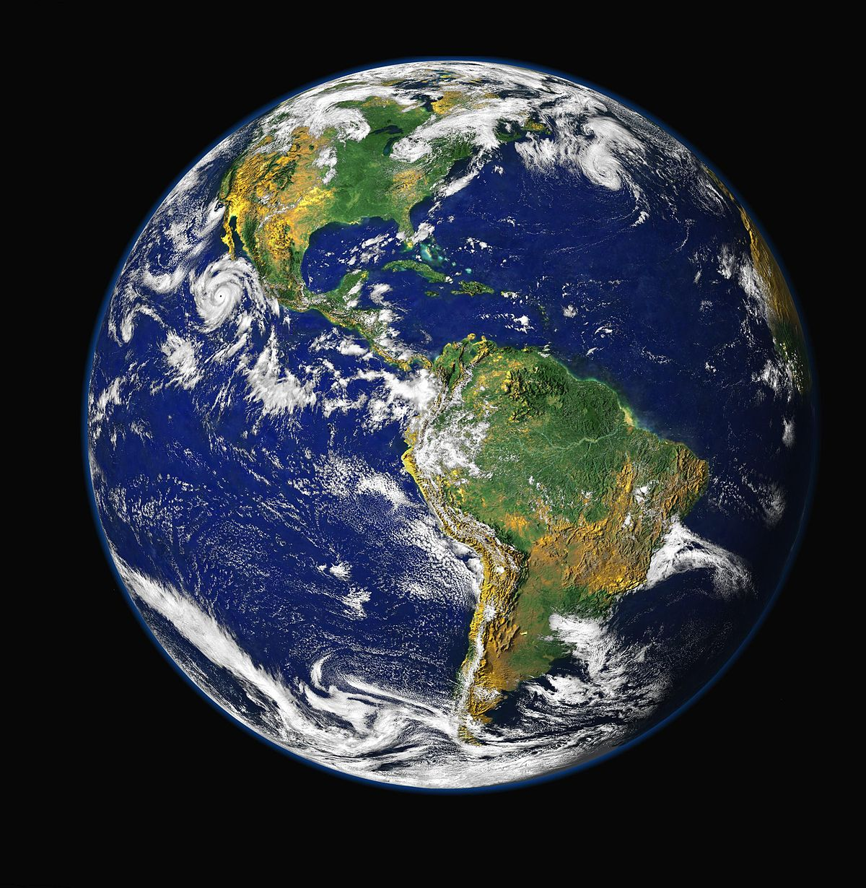
Protecting Our planet and Environment: an Earth day presentation
Kaycee Reed
This Photo by Unknown Author is licensed under CC BY-SA

Slide 2
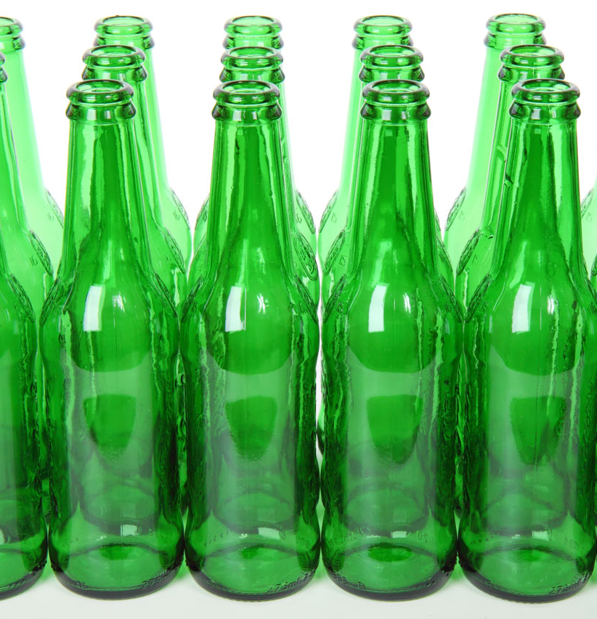
In this Presentation
Earth day was founded by a man named gaylord on April 22, 1970
Over a 100 pieces of junk is delivered to America each year
For reduce u can fix and use again
Reuse u can use bags u use before again
To recycle u can put the trash that can be recycled in the green bin
To save energy u can turn off your lights and use a flashlight

Slide 3
Five Facts about earth day
Celebrated on April 22
In china on earth day many people rode bike to reduce and save fuel.
Some schools celebrated earth day to expand their time frame.
On the first day of earth day 20 million people protested.
Every year men, women, and children gathered trash on earth day.

Slide 4
Reduce & reuse
What and why
How to reduce and reuse
Help sustain the environment for the future generations.
Allow products to be used to their fullest.
Buy things that aren’t a lot and good to use.
Main product by fixing things like ,clothes, tires and other things
Borrow ,rent, or share things that can be reused.
Save money

Slide 5
Recycle
What and why
How to recycle
Increase security by tapping a domestic source of material.
Help American manufacturing and conserve valuable resources.
To recycle u can put put trash in certain bins
Recycle bottles in a green bin
Recycle can in a red bin
Recycle news paper in a blue bin

Slide 6
Energy conversation
What & why
Ways to say energy
Why is because if u save energy the things in your house wont go out so fast
What would u do to save energy??
Turn off the light
Unplug your tv
Stop running water for a long time
Turn off the air

Slide 7
sources
https://www.epa.gov/recycle
https://tntel.info/resource/world-book-online
https://school.eb.co.uk/levels

